Slide 1
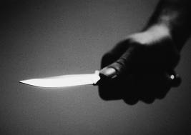
Stabbing Investigations

Slide 2
Learning Objectives
Define the difference between stab wounds and cutting wounds
Identify steps to take when responding to a stabbing investigation as a patrol officer
Identify what defensive wounds look like
Identify suicide vs murder indicators

Slide 3
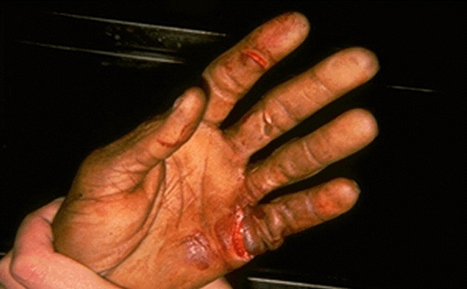
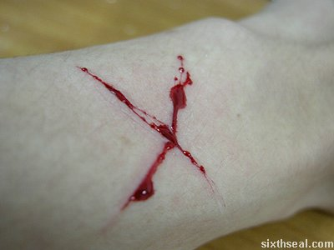
Stab Wounds vs Cutting Wounds
Stab Wounds – Caused by thrusting actions. Usually smaller than cutting wounds. Death is usually caused by internal bleeding.
  Defense Wounds – usually seen on the hands, arms and legs. Caused by victim trying to fight off the attacker
Cutting Wounds – Usually the cause of suicide and death results because of external bleeding.
  Hesitation Wounds – Less severe, superficial cutting in area of actual wound that causes death.
Notes:
Stabbing wounds are most likely going to be responsible for damage to the internal organs. The wound may go deeper than the actual knife length itself due to the thrusting motion when stabbing.

Slide 4
Suicide vs Murder Indicators
Suicide Indicators:
  Hesitation Wounds
  Wounds under clothing
  Weapons present, especially if tightly gripped
  Wounds at throat, wrist or ankles
  Seldom disfigurement
  Body not moved
Murder Indicators:
  Defense Wounds
  Wounds through clothing
  No weapon present
  Usually injuries to vital organs
  Disfigurement
  Body Moved
(Hes, K.,& Orthman, C., 2010, p. 275).

Slide 5
Patrol Officer Responsibilities when Responding to a Stabbing
Secure the scene
Begin taking crimes scene notes right away
Begin a crime scene entry log right away
Call for Detective Unit and Medical Examiner
DO NOT TOUCH ANYTHING!
Remember the Golden Rule of crime scene investigations.
Once the investigation begins, the following steps will need to be taken:
  Canvass the area
  If no knife is located, search the area (inside and out)
  Document, Photograph, Diagram
  If defensive wounds are visible, the hands and feet should be wrapped in a paper bag using paper tape to preserve any possible physical evidence.
Notes:
Remind students this is the same as any other investigation. Touch on such things as:
* Not fingerprinting body if print is found prior to going to medical examiner’s office
* If windows or doors are closed, don’t open, if open, don’t close. Do not alter the scene in any way.
Remind officers that the first one on scene can make or break a case.
Canvassing – Discuss this in the aspect of looking for witnesses that may of saw or heard anything unusual.

Slide 6
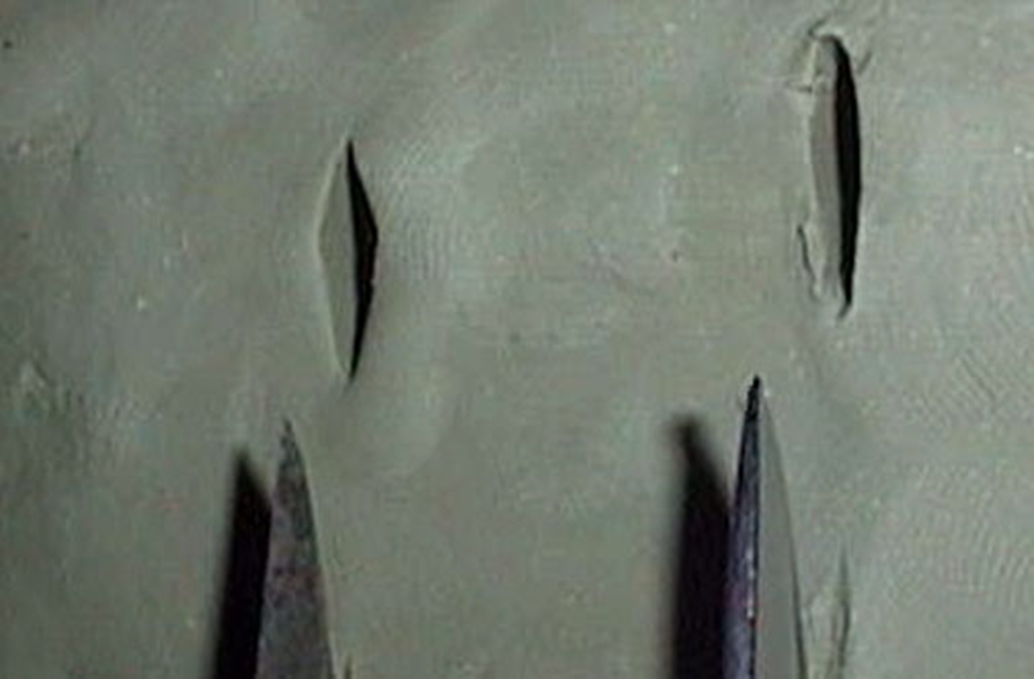
Double Edge vs Single Edge
Notes:
Explain how these look different. Will provide clues as to what type of knife is being looked for.

Slide 7
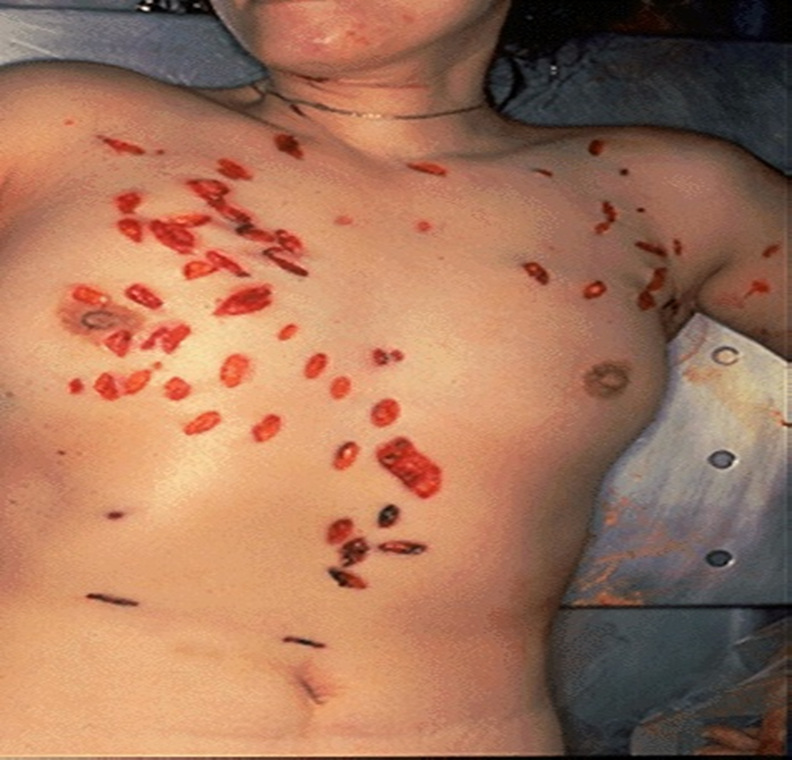
Notes:
Assailant will profile self with the evidence left behind. Assailant motivated by anger and sexual deviancies in this case.

Slide 8
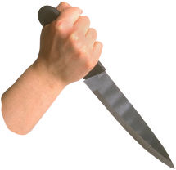

Questions?

