Slide 1
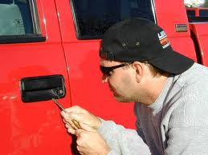
Auto Theft Investigations

Slide 2
Learning Objectives
Identify common methods for stealing vehicles.
List ways in which to recognize a stolen vehicle that is parked and a stolen vehicle that is moving.
Describe locations a VIN can be found on a vehicle.
Explain how vehicles are cloned
Identify signs of professional and amateur chop shops
List questions that should be asked when taking a stolen vehicle report.
Identify the proper crime upon finding someone in a stolen vehicle.

Slide 3
In Washington State……..
A car is stolen every 13 minutes
106 cars are stolen everyday
Your car has a 1 in 179 chance of being stolen
1 in every 5 cars were stolen with a key left inside.
According to the National Crime Insurance Bureau (NICB), Washington ranks 7th in auto thefts.
Notes:
Source: Washington State Patrol, http://www.wsp.wa.gov/crime/autotheft.htm, 2012

Slide 4
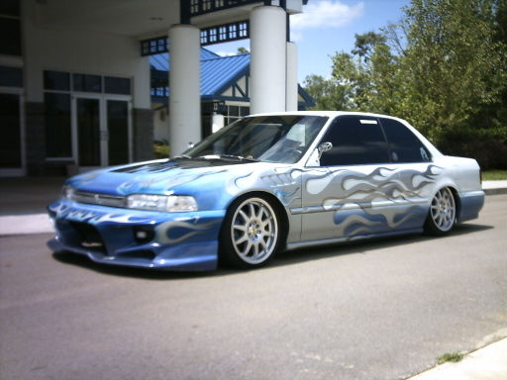
Washington’s Top 10 Stolen Vehicles (Source: 2010 NICB)
1. 92 Honda Accord 6. 94 Nissan Sentra
2. 95 Honda Civic 7. 93 Dodge Caravan
3. 90 Toyota Camry 8. 98 Saturn SL
4. 95 Acura Integra 9. 94 Ford Explorer
5. 93 Subaru Legacy 10. 95 Nissan Pathfinder

Slide 5
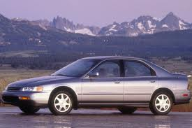
National Top 10 Stolen Vehicles Source: 2010 NICB
1. 94 Honda Accord 6. 04 Dodge Ram
2. 95 Honda Civic 7. 00 Dodge Caravan
3. 99 Toyota Camry 8. 94 Acura Integra
4. 97 Chevy Pickup 9. 02 Ford Explorer
5. 97 Ford F150 10. 99 Ford Taurus

Slide 6
How are vehicles stolen?
Notes:
Lead a class discussion in how vehicles are stolen.

Slide 7
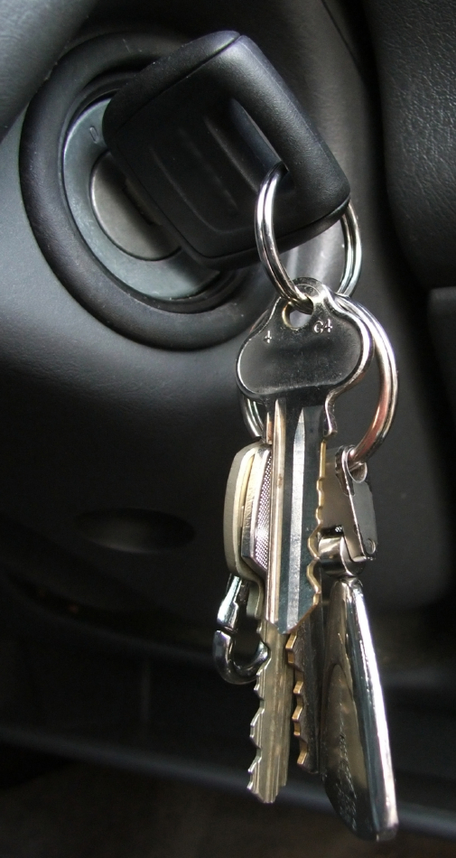
Notes:
Refer to first slide, where 1 in every 5 cars were stolen with a key inside.

Slide 8
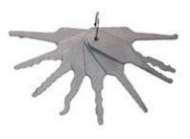
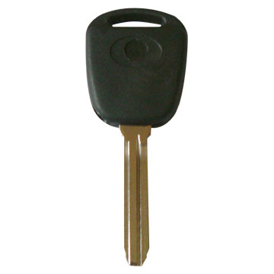
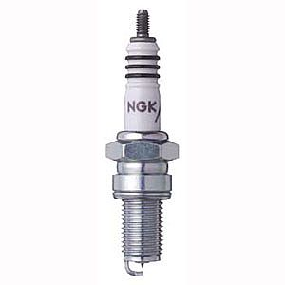
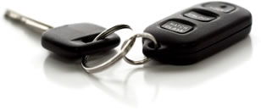
Tools of the Trade

Slide 9
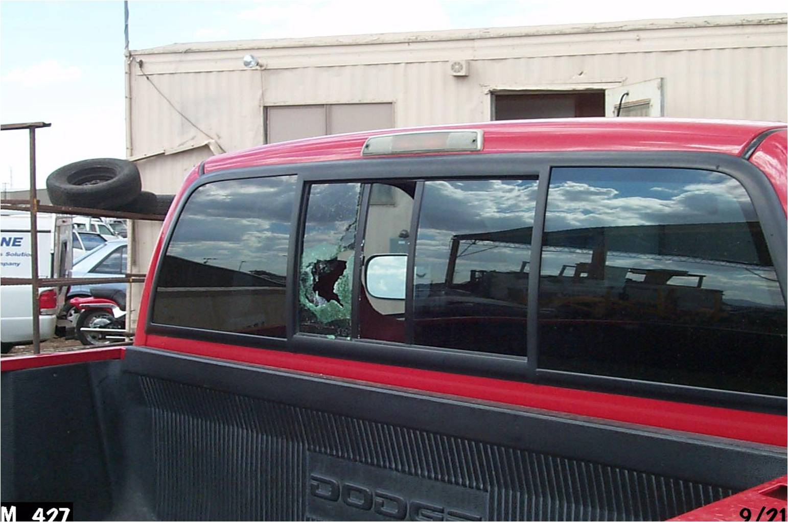

Slide 11
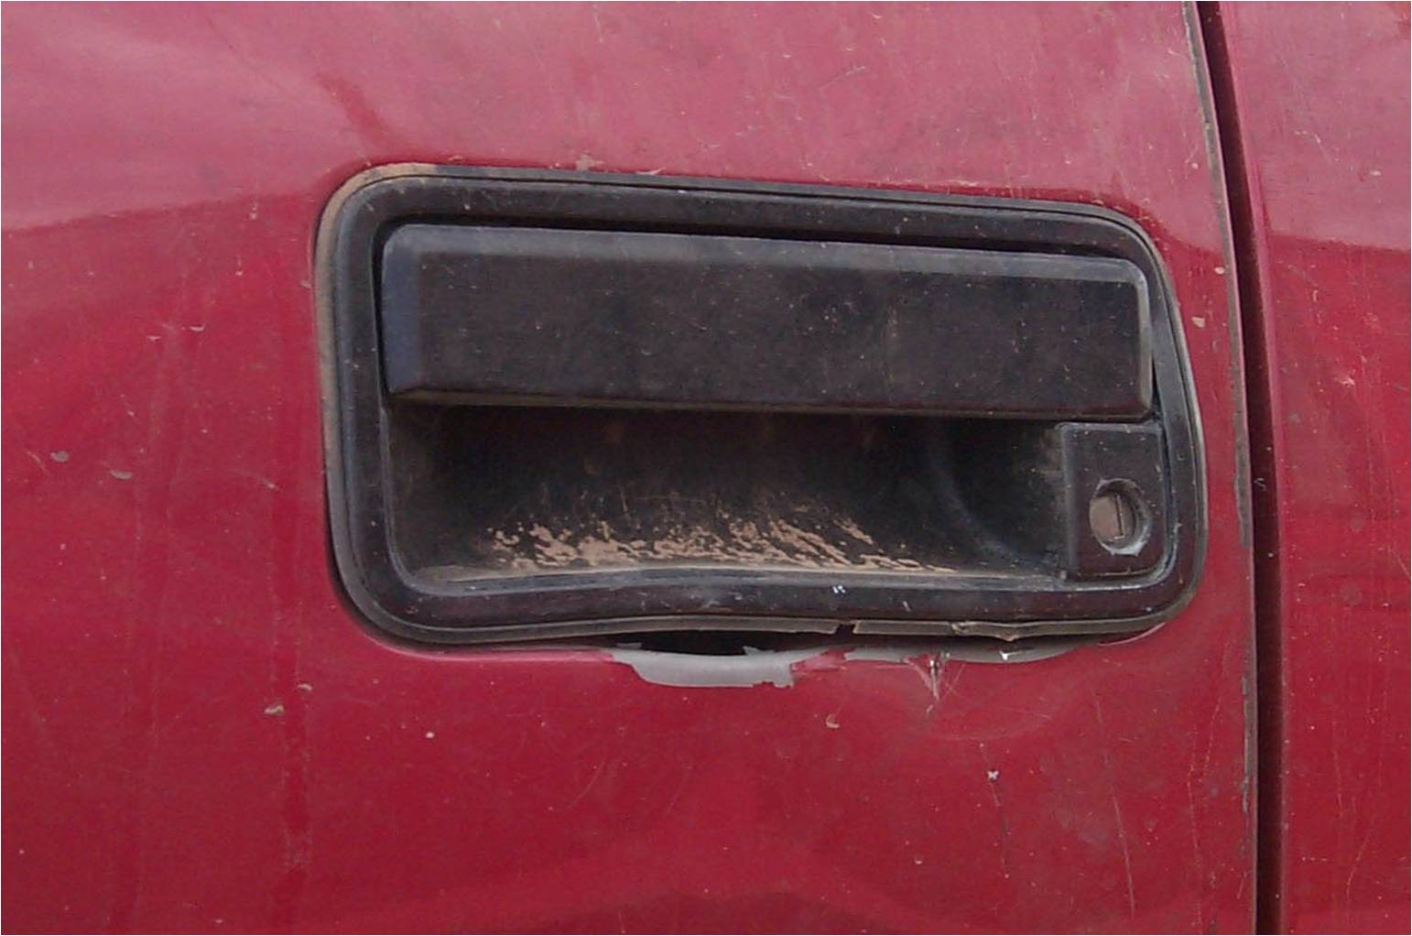

Slide 12
Where are VIN’S located?
Door frame
Dash near windshield (driver’s side)
Engine itself
Car’s firewall
Left hand inner wheel arch
Steering wheel/ steering column
Radiator support bracket
Vehicles title/ registration
Notes:
Before showing this slide, have students try to name locations to find VINS.
How many digits in a VIN – 17 after 1981.

Slide 13
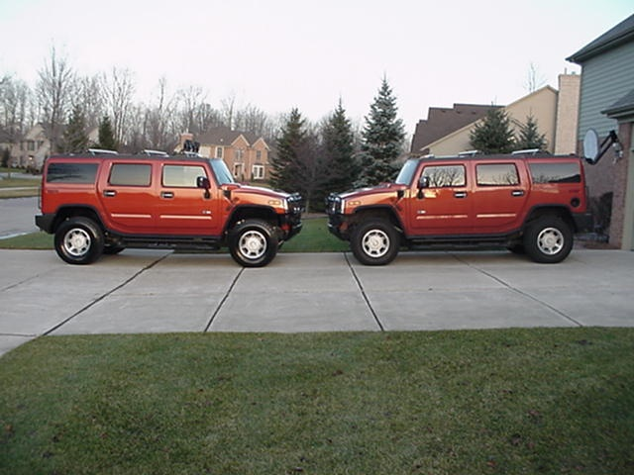
Vehicle Clones
The definition of vehicle clones by the NICB is: stolen vehicles that assume the identity of legally owned, or “non-stolen” vehicles of a similar make and model.
Notes:
Source: Hess, K. & Orthmann, C. 2010, p. 462.

Slide 14
Cloning Process
Copy a VIN from a legally owned vehicle.
Criminal steals a similar make and model vehicle that they have a VIN for.
Stolen vehicle’s legitimate VIN is replaced with a counterfeit VIN - which makes the stolen vehicle a clone of the legally owned vehicle.
Criminal creates counterfeit ownership documents and sells the vehicle to an innocent buyer.
Notes:
Source: Hess, K. & Orthmann, C. 2010, p. 462.
The FBI recently broke up one of the largest theft rings in the country. Over 1000 cars worth 25 million dollars were taken from Florida, Illinois and Mexico, all cloned vehicles. Owners will still be responsible for any outstanding liens. (Carfax Report, 2011).

Slide 15
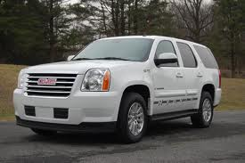
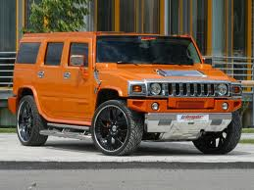
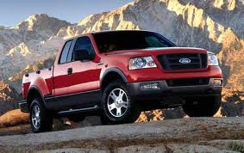
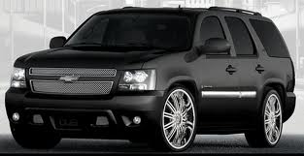
2007 Top 5 Cloned Vehicles
Notes:
Cadillac Escalade
Hummer H2
Chevrolet Tahoe
GMC Yukon
Ford F Series Pickup

Slide 16
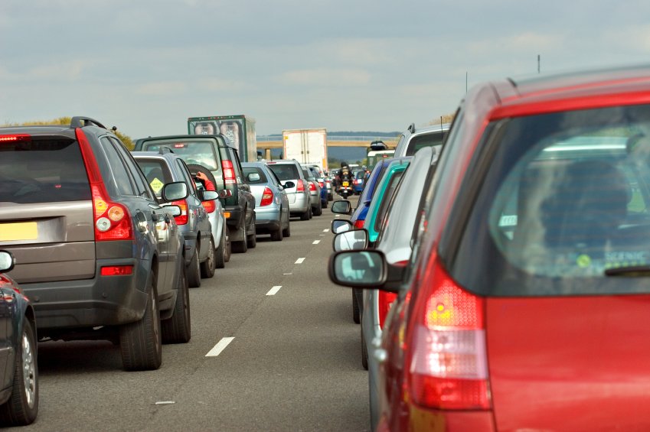
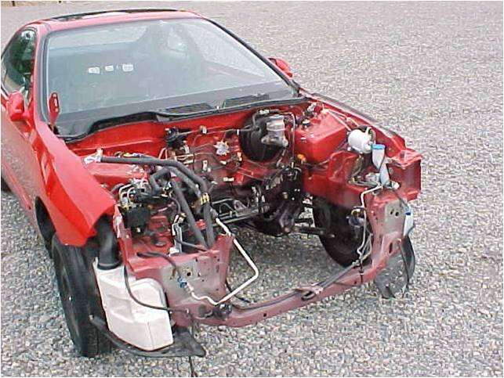
How to Recognize Stolen Vehicles
Rolling / Mobile * Stopped/ Parked
Stopped / Par
Notes:
Have class break into two groups (have students count off in two’s). One group will cover Rolling/ Mobile, the other will cover Stopped/ Parked. Students should have 5 minutes to determine what they will be looking for in a stolen vehicle and what a good cop should be looking for?
Also, during this block, talk about LOJACK. (Info only – LOJACK now offers same locator device for computers).
After the brainstorm, have groups report out and spend a few minutes discussing.
CHARACTERISTICS of a DRIVER of a STOLEN VEHICLE: sudden jerks or stops, driving without headlights, excessively fast/ slow, wearing gloves in hot weather, avoiding patrol vehicle, youthful appearance of driver (juveniles account for 16% of car thefts).
CHARACTERISTICS of A STOLEN VEHICLE: one license plate when two are required, old plates with new screws, dirty plates on clean car or clean plates on dirty car, different front and rear plates, broken windows or door locks, broken steering column,

Slide 17
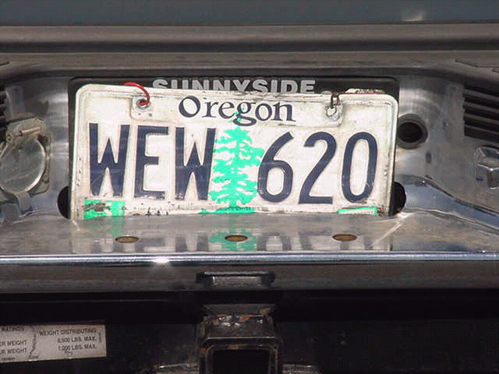
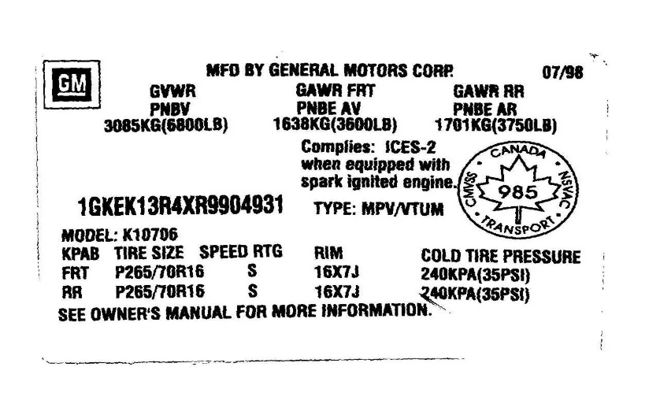
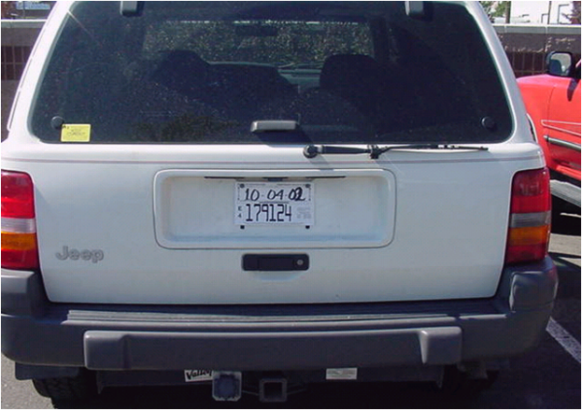
Signs of Stolen Vehicles
Notes:
Vehicle hanging on buy wire over another license plate.
Altered Temp Tag
18-Digit VIN – Should only be 17 digits

Slide 18
Why are Vehicles Stolen?
Fun/ Excitement/ Adrenaline/ Joyride
Largest part of vehicle thefts fall under here
Gang initiations
Crime of opportunity
Items stolen from vehicle
Transportation - temporary
Transient, hitchhiker, runaways
Vehicle to get from point A to point B
Steal another vehicle where first one is abandoned
Abandons when gas runs out
Type of vehicle not a consideration
Recovery rate is usually high, with little to no damage to vehicle.

Slide 19
Why are Vehicles Stolen Cont.?
Transportation to commit other crimes
Robbery
Check/ Credit card fraud
Burglary
Thefts
Drug Transactions
Profit/ Professionals
High profit/ low recovery rate
Very organized groups
Chop Shops
Salvage fraud
Clones
Notes:
Another reason is for insurance fraud – cover this with students.

Slide 20
Chop Shops
Title 18 U.S.C Sec 2322
Chop Shop - defined as any building, lot, facility or other structure or premise where one or more persons engage in receiving, concealing, destroying, disassembling, dismantling, reassembling, or storing any passenger motor vehicle or passenger motor vehicle part which has been unlawfully obtained to alter, counterfeit, deface, destroy, disguise, falsify, forge, obliterate, or remove the identity, including the VIN, or derivative thereof, of such vehicle or vehicle part and to distribute, sell, or dispose of such vehicle or vehicle part in interstate or foreign commerce.
Notes:
Resource: Cornell University Law School - http://www.law.cornell.edu/uscode/text/18/2322

Slide 21
Amateur vs Professional Chop Shops
Amateurs
Limited tools
Parts removed haphazardly
Valuable parts damaged
Valuable parts left on vehicle
Professionals
High end tools
Parts removed carefully
Valuable parts undamaged
All parts removed
Notes:
Recent figures show that about 25% of stolen cars are taken by professional thieves for chop shops.
Purpose of chop shop: hide identify of stolen vehicle and quickly turn them around for profit.
Chop Shop mechanics can dismantle a vehicle within 1-2 hours.
Chop shop operators will purchase cars at salvage yards strictly for their VINS, then steal car of same make/ model, change VINS, and claim the vehicle as a salvaged vehicle getting a clean title. These vehicle usually go over seas on the black market.

Slide 22
How do I Identify a Chop Shop?
Late night activity
Vehicle parts littering surrounding area
Activity is not normal for the area
No legitimate business/ not licensed
Criminal history of associates/ occupants
Citizen complaints
Informants
Stripped stolens recovered in the area
Notes:
Discuss with class what course of action should be taken if they identify a possible chop shop.

Slide 23
Things to Remember
Evidence to be looking for:
Fingerprints
Evidence of other crimes
VIN’S/ Rivets
Does it appear the VIN has been tampered with?
Resources:
NICB (National Insurance Crime Bureau)
WSATI (Wa State Auto Theft Investigators)

Slide 24
Things to Remember Part 2
When a suspect is caught in a stolen vehicle, knowledge is the key element that must be proven. If this is not proven, what crime do you have?
Questions to ask the victim:
Does anyone have permission to use the vehicle?
Did you lend the vehicle to anyone?
Was it stolen with the keys or without?
How many plates were on the vehicle when it was stolen?
Are there any distinguishing characteristics that will help identify the vehicle?
In order to enter a vehicle into NCIC/ WACIC as stolen, you will need to obtain a signed stolen declaration waiver.

Slide 25
Group Exercise
Group 1 – Robbery
Group 2 – Burglary/Vehicle Prowl
15 minutes to create a checklist:
What will you look for?
What will you ask?
Notes:
Break the class up into two’s for this assignment. The same groups can be used that were used for the last group exercise with rolling stolen vehicles vs. Stopped/ parked stolen vehicles.
Lead a short discussion after the groups are done working about what they came up with.

