Slide 1
Intro to Traffic Stops
Traffic Enforcement, Module 4

Slide 2
Learning Objectives
Describe, compare and contrast moving and stationary patrolling techniques as methods to locate violators
List and explain the elements and importance of the pre-stop survey
List and explain use of radio procedures and emergency lights for traffic stops
Explain positioning of a police vehicle during a traffic stop
Explain approaches to, and officer positioning at, various types of suspect vehicles
Explain the parameters of a driver contact as discussed in class

Slide 3
Learning Objectives
Outline the parameters of breaking contact with a violator, returning to the patrol vehicle and safely completing an investigation and paperwork as discussed in class
Compare and contrast the two different charging documents used in Washington State
List the different ways a police officer can issue a traffic infraction as discussed
List the important elements in writing citations
Write a simulated citation given a driver's license and relevant citation information
Explain the steps to close a contact with a violator

Slide 4
Problem Statement
You are on patrol at 2344 hours in a suburban area when you receive a call from dispatch advising you of a possible drunk driver in your area, proceeding eastbound on 18th Street. The vehicle is described as a black, older model, Chevy Camero with a partial plate beginning with BR. The caller indicated the vehicle had cut her off; that she began following it and had observed it run a stop sign. The complainant had last seen the car turn onto eastbound 18th Street, and she believed the driver to be either sick or drunk.
As you wait to pull onto 18th, you observe a black Pontiac Firebird going eastbound past you. It appears the vehicle has a driver’s side headlight out and that the driver is not wearing a seatbelt. You pull onto 18th and follow the vehicle. Within ¼ of a mile or less, you observe that the vehicle is drifting in and out of its lane of travel, crossing the fog line several times and traveling under the speed limit.

Slide 5
Traffic Enforcement Patrol Methods

Slide 6
Planning your stop
Stopping the violator
Contacting the violator
Determining the enforcement action
Closing the contact

Slide 7
Planning Your Stop
The Pre-Stop Survey

Slide 9
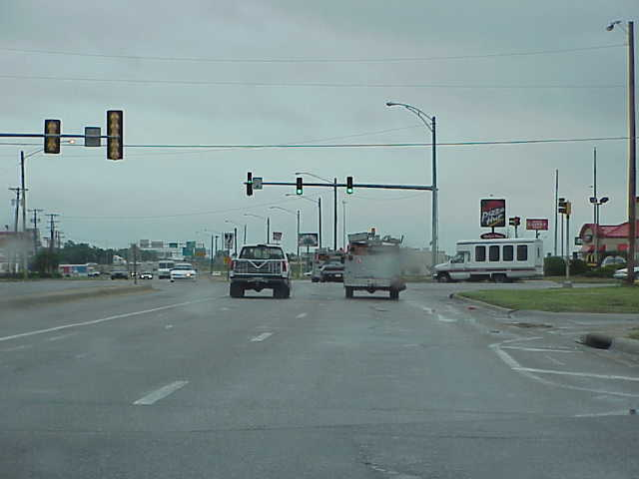
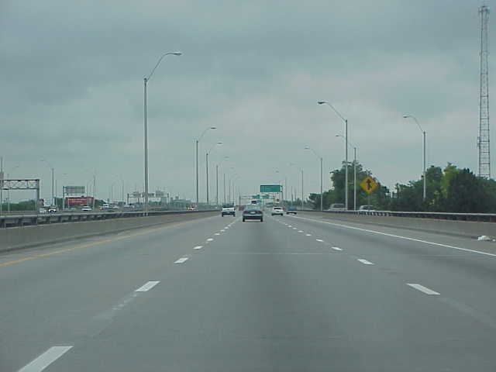
Stopping Locations
Notes:
Left Photo – Bad location…No shoulder, too close to intersection
Right Photo – Bad location…On a bridge

Slide 10
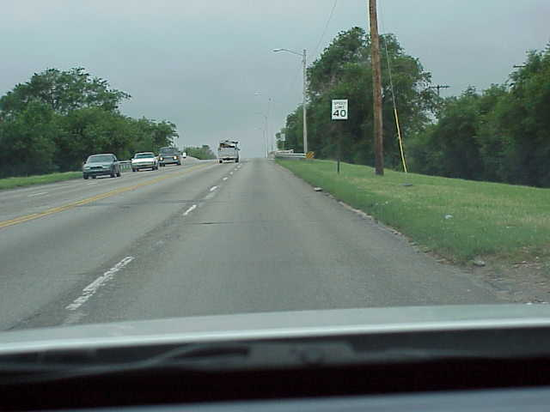
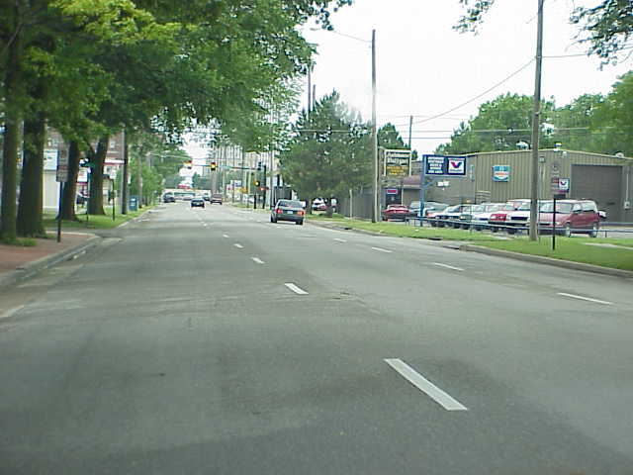
Stopping Locations
Notes:
Left Photo – Bad location…No shoulder
Right Photo – Bad location…Heavily traveled, no shoulder

Slide 11
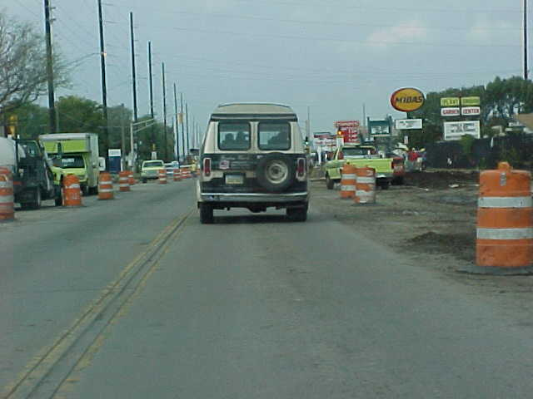
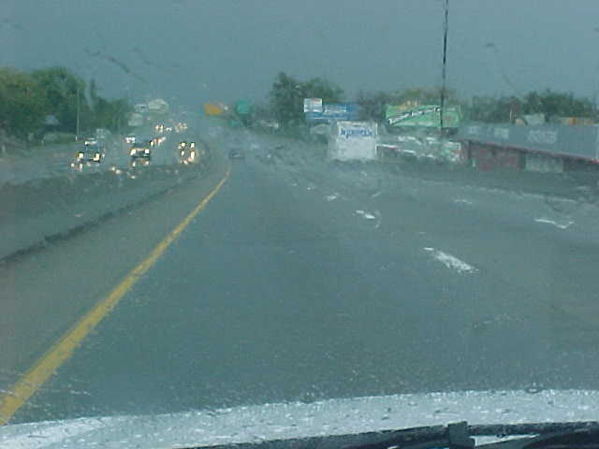
Stopping Locations
Notes:
Left Photo – Bad location…Construction, no shoulder, heavy traffic
Right Photo – Bad location…Weather, limited shoulder, heavy traffic

Slide 12
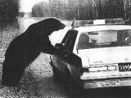

Slide 13
Planning your stop
Stopping the violator

Slide 14
Stopping the Violator
Radio
Signaling
Precautions
Positioning

Slide 15
Your Vest Won’t Stop…

Slide 16
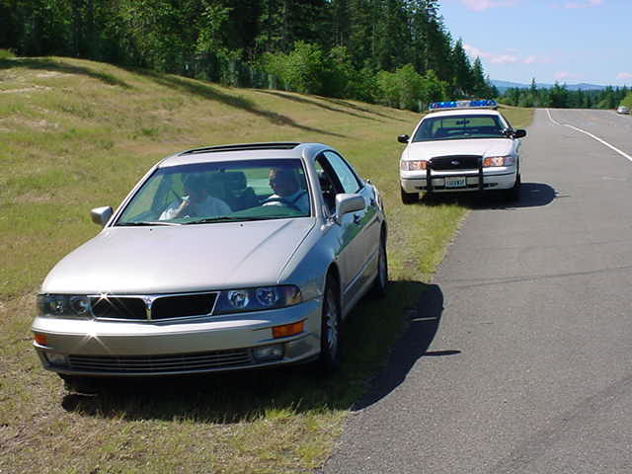
Position #1 - Offset
Notes:
Off Set position
Question: What’s wrong with this photo?
Answer: The tires still need to be angled to the left.

Slide 17
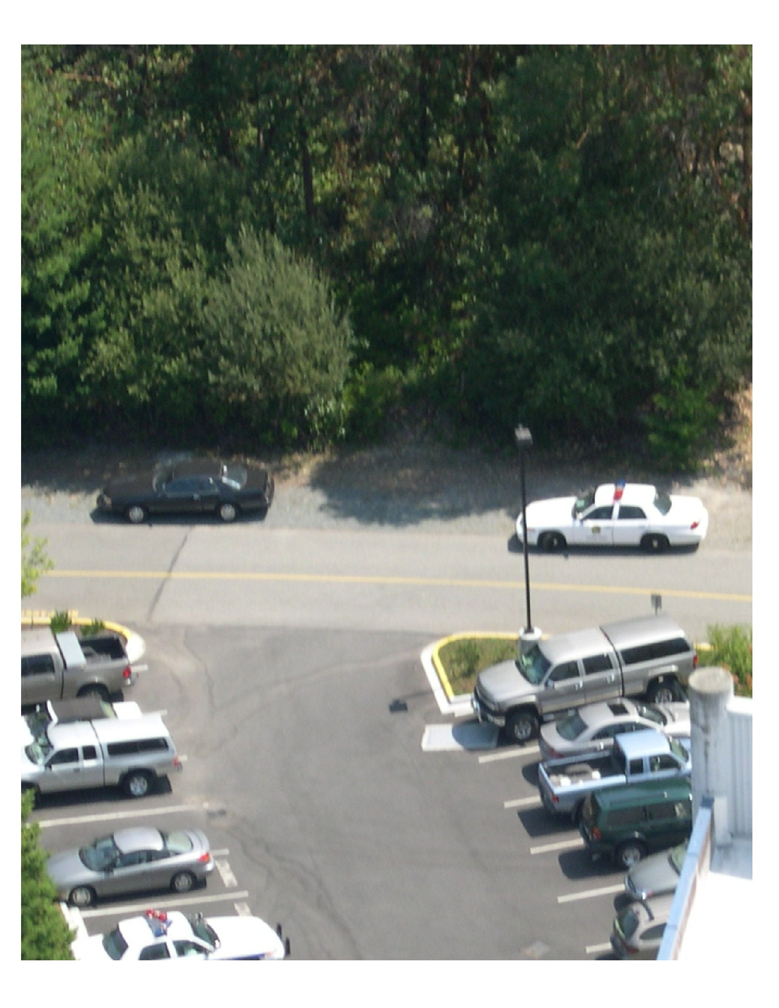
Notes:
Positives
Allows good view of driver’s side
Allows all of the patrol vehicle’s lights to be used effectively in the “curtain of light.”
Does not expose the passenger officer
Protection from traffic on approach
Cons
Does not allow for the most effective use of the engine block for cover

Slide 18
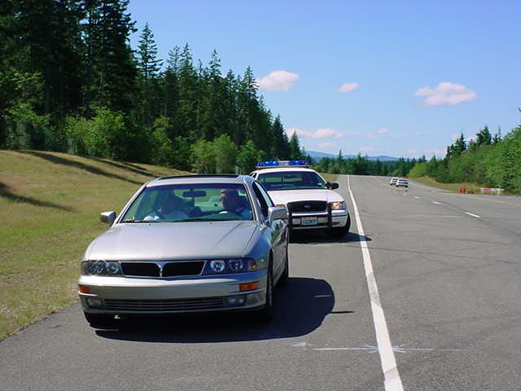
Position #2 - Angle
Notes:
Notice that the patrol car’s front left tire is 1 ½ to 2’ from the fog line and that the tire is at an angle.

Slide 19
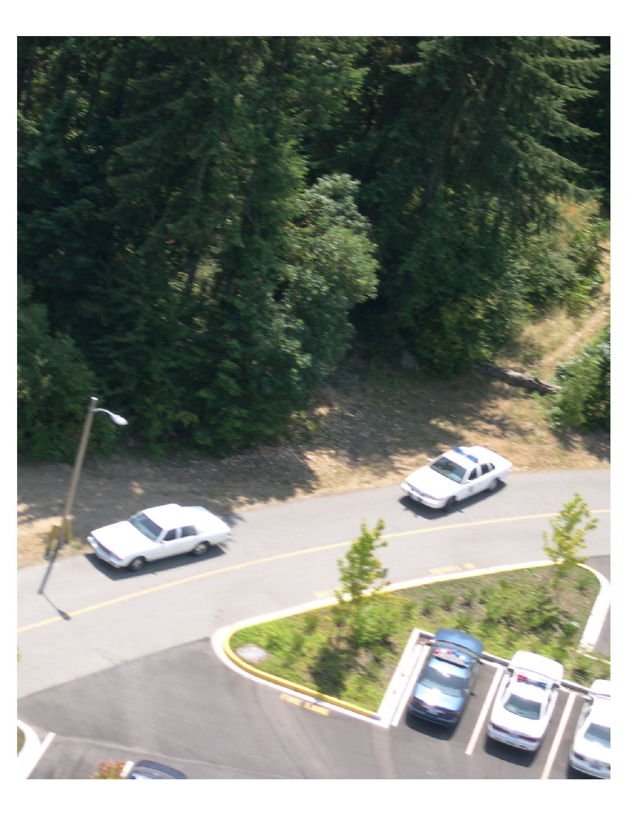
Notes:
Turn wheels all the way to the left on every position.
Why?
(1) If your patrol car is struck from behind it will be forced out into the other lane of travel keeping it from striking you if you are walking up to or back from the violators car.
(2) To pick up skipped rounds from the violator.
Positives
Good view of the driver
Protection from traffic during approach
Maximizes protection from the engine block
Cons
Officer has to step closer to traffic to pass the right front corner of the patrol car
Passenger officer exposed to violators
Does not allow for best use of patrol car lighting at night

Slide 20
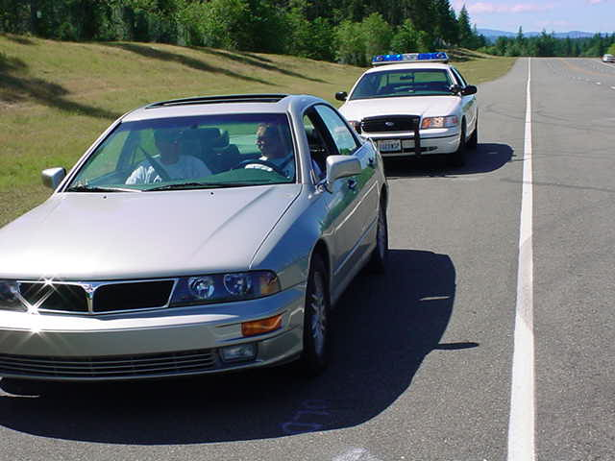
Position #3 - Inline
Notes:
Notice the tires still need to be angled to the left.

Slide 21
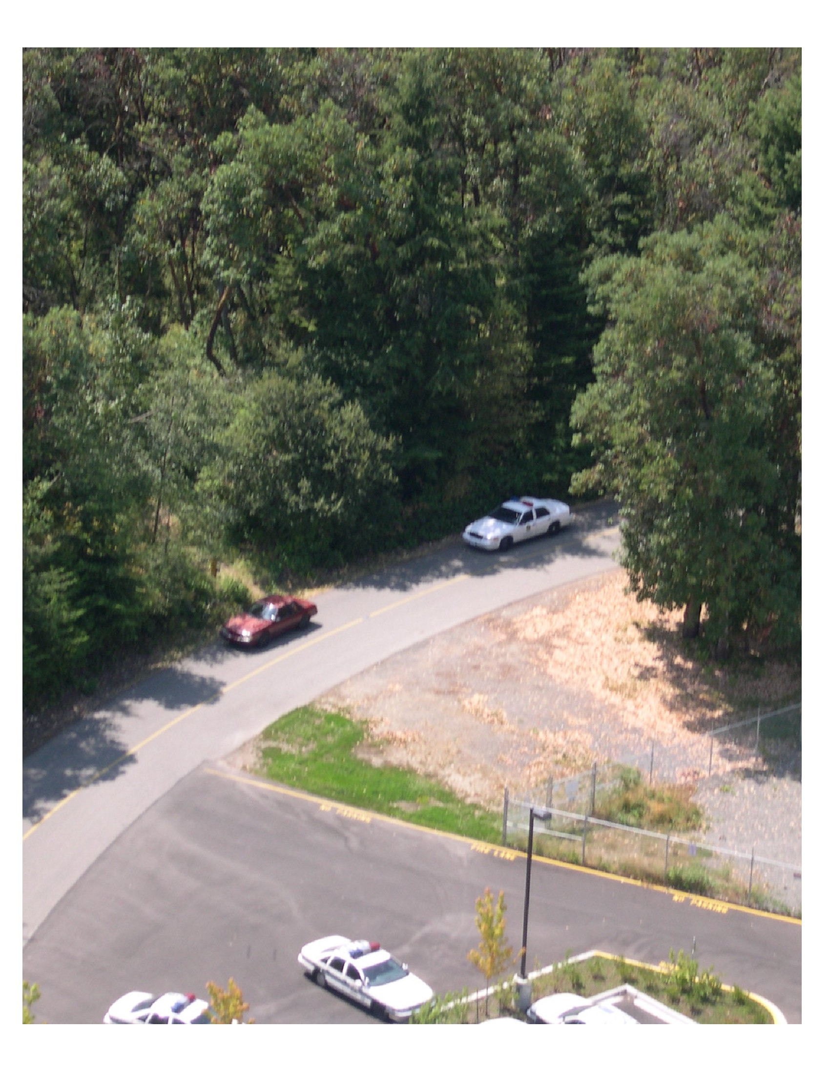
Notes:
Positives
Good view of driver and passengers
Maximizes the use of all patrol car lighting equipment
Driver and passenger officers both afforded some protection from the engine block
Negatives
No protection from passing traffic on approach

Slide 22
Planning your stop
Stopping the violator
Contacting the violator

Slide 23
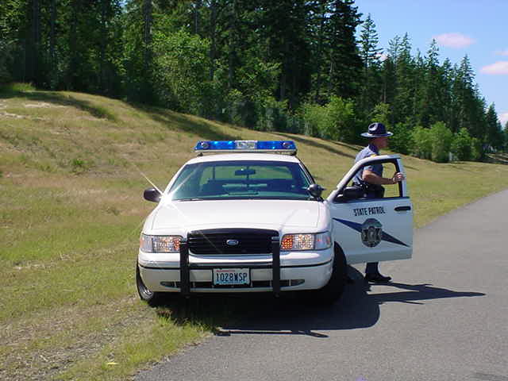
Exiting Your Vehicle
Notes:
Checking for Traffic/Threat assessment before exiting the vehicle.
Look over left shoulder.
1. The most hazardous time is now.
Getting out of your vehicle exposes you to traffic.
Officer cannot see the violator or occupants well.
Only real protection you have is your bullet vest and ability to observe and react.
2. Don't let the violator beat you out of the car. It could be fatal.
Be prepared -- that doesn't mean you should rush up to the violator's car -- pause and observe.
Don’t let yourself get careless. You only step into the path of a car once.

Slide 24
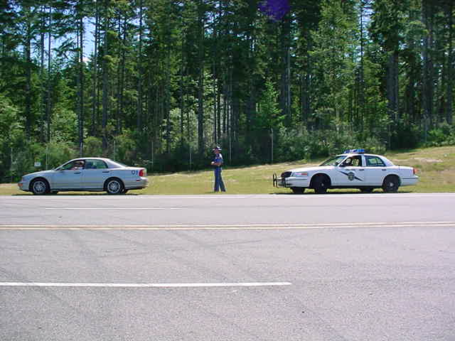
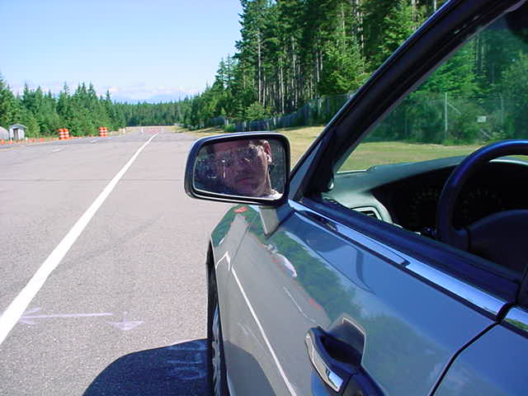
Approach
Notes:
Officer may approach on either side of vehicle.
Your choice of which side to approach on is dependent on your traffic and/or threat assessment.
RIGHT SIDE APPROACH: Statistics are proving that right side approaches to the violator’s vehicle to be the safest method in majority of contacts on busy streets or freeways.
Refer to hand out showing walking path of officer. (Vehicle Position – Hand out)
Left side: Walk directly up, utilizing patrol vehicle as cover from behind traffic.
Right side: Walk slightly to the right of side mirror of suspect vehicle.

Slide 25
Directing Occupants
Violators
  Remaining in vehicle
  Exiting

Slide 26
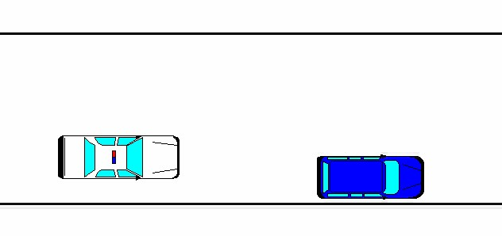
Call Back Technique
Notes:
Why call the violator out of the vehicle?
The violator exits his car and refuses to get back inside.
The violator exits his car and you do not want him to get back inside (impaired, multiple passengers

Slide 27
Directing Occupants
Violators
  Remaining in vehicle
  Exiting
  Refusing your directions
Passengers

Slide 28
Point of No Return
Notes:
Use the patrol car to protect you from traffic during the approach.
Stop at the left rear corner of the violator vehicle.

Slide 29
Checks & Pauses
Notes:
Use the patrol car to protect you from traffic during the approach.
Stop at the left rear corner of the violator vehicle.

Slide 30
Checks & Pauses
Notes:
Left or Right rear corner to the “C” post and then to the “B” post.

Slide 31
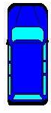
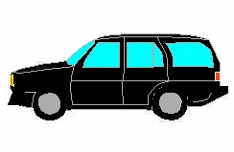
Officer Positioning
Notes:
From the front of the car:
A post
B post (red line)
C post

Slide 32
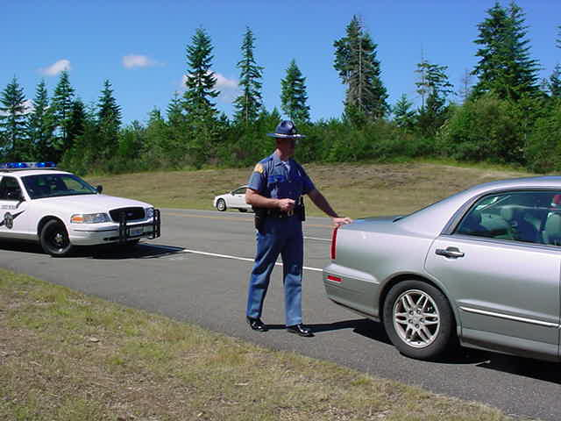
Driver or Passenger Side?
Notes:
Flashlight usage
A good time to turn on your flashlight in hours of darkness is when you reach the trunk. Turning it on too early lets the violator know which way you are approaching. This takes away the element of surprise.
Consider waiting to turn on your flashlight when you reach the “C” post on a passenger side approach unless you have been seen approaching, then turn your flashlight on when you reach the trunk.

Slide 33
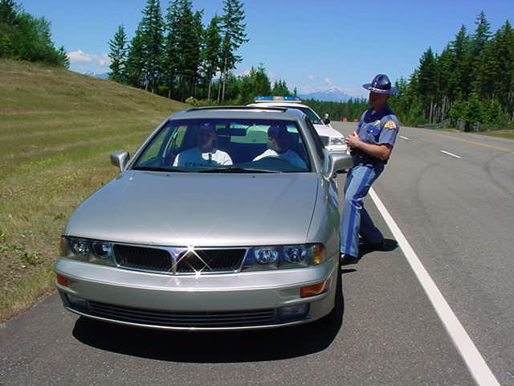
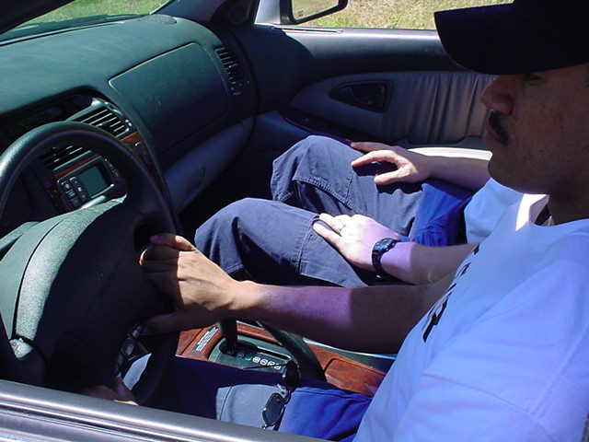
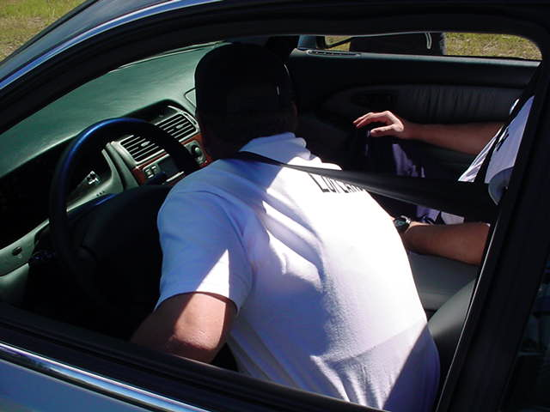
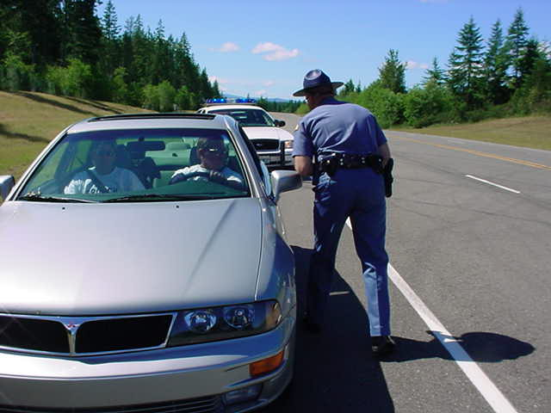
Driver’s Side Contact Views
Notes:
Lower right photograph – “A” post position
Make sure you get all paper work and place violator and passengers hands where you can see them before you move past the “B” post. If the hands start to move, you order the occupants to stop moving their hands as you retreat back behind the “B” post.
Reasons an officer would move to the “A” post:
You decide traffic is a greater threat than the vehicle’s occupants.
You decide you need a better view of the violator’s right side.
You decide you need a better view of the center consol area.
Negative aspects of moving to the “A” post:
You are in full view of the vehicle occupants.
You will not be able to out draw an occupant and they will have you in full view
Your options for moving out of the danger zone are not as good.

Slide 34
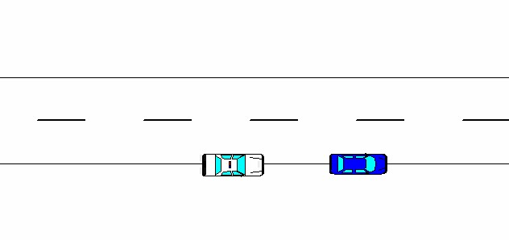
Right/Passenger Side Approach
Notes:
Consider the passenger approach as stealthier alternative to the driver’s side approach.
Try not to give your position away until the last possible moment.

Slide 35
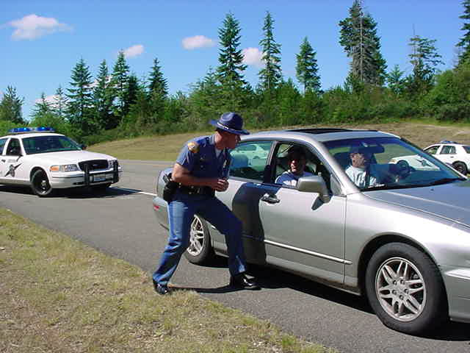
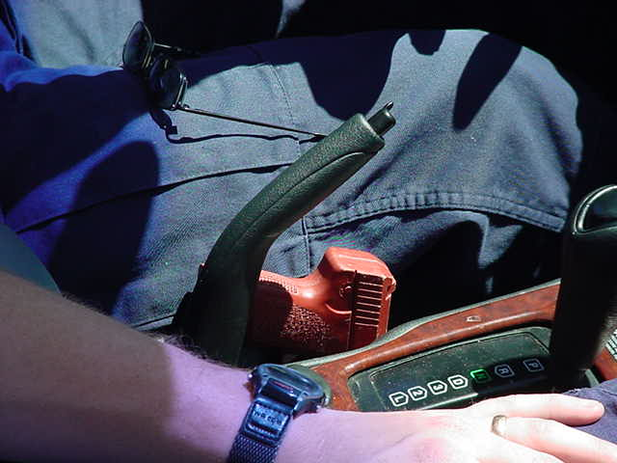
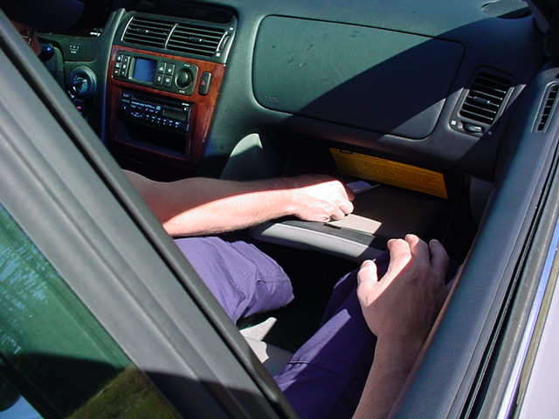
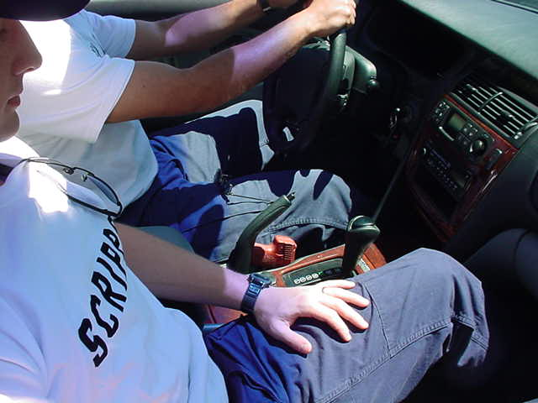
Passenger Side Contact Views
Notes:
Right side contact:
a. The violator usually does not expect it. This gives the officer the element of surprise.
b. Best view of occupant's right hand -- 90 percent of people are right-handed.
c. Better view of vehicle interior.
d. Ability to observe contents of glove box or console.
e. Less distractions -- attention is not divided between traffic and violator.
f. Can hear better if traffic is heavy.
g. Cannot be pushed into traffic.
h. Have multiple escape routes.
i. Don't lean inside car.
j. Don't lean against car, you could damage the car. (The department pays for it)

Slide 36
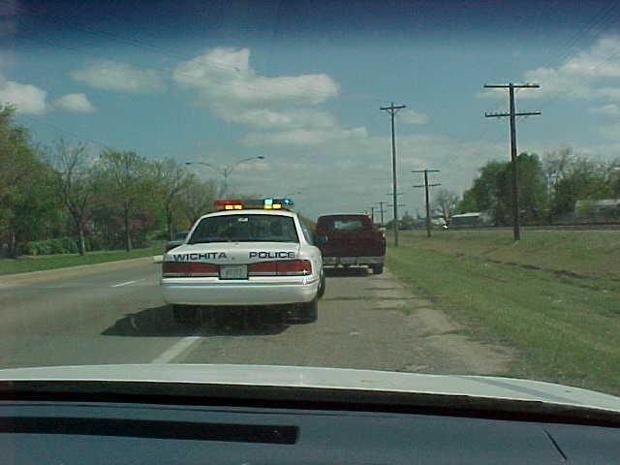
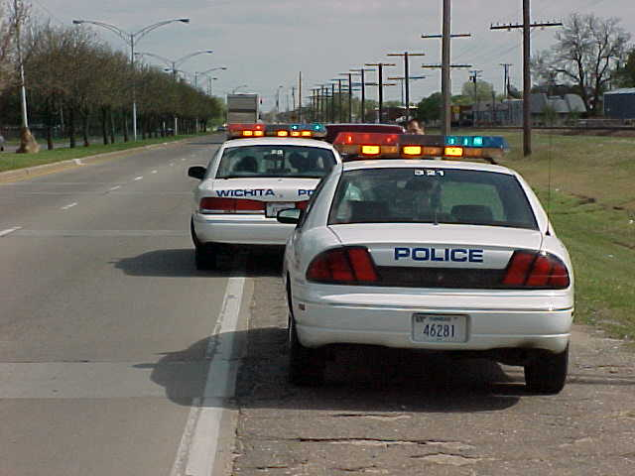
Back-Up Unit
Notes:
Back up unit positions vehicle to give primary unit additional protection
In this case, the back up unit does not want to further block the roadway
You are the cover officer, do not take independent action unless absolutely necessary
Do not back light the primary officer by leaving your headlights or rotators on during a night time stop.

Slide 37
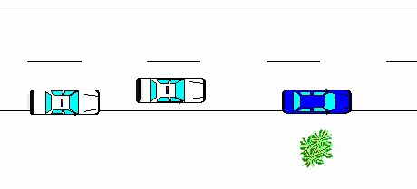
Back-Up Unit
Notes:
The back up unit’s position depends on the primary unit’s position.
Keep some space between the units, and don’t forget to turn the front tires all the way to the left.

Slide 38
Greeting the Violator
Notes:
Minorities often think officers are on a fishing expedition when they do not provide his/her name and the reason for the stop up front.
The minorities reported that when officers give their name and reason for the stop the stop proper and not racially motivated.

Slide 39
Contact Model
Verbal Greeting
Exchange of Info
Observe and Investigate
Determine Action
Close the Contact

Slide 40
Planning your stop
Stopping the violator
Contacting the violator
Determining the enforcement action

