Slide 1
Use of Force I
Detective Jeff Paynter
Officer Sean Hendrickson

Slide 2
Basic Concepts
What is force?
  Any action that influences the actions of another, via verbal direction, compulsion, constraining power, strength directed toward an end, and/or causes motion.

Slide 3
Coercive Force
Any action that produces FEAR to compel compliance, to deter action or to suspend violator resistance.
Threats to employ physical force while not physical, can often be effective.
All proper use of physical force is intentionally coercive regardless of its effectiveness.

Slide 4
Basis for use of force
Federal Law - 490 U.S. 386
State Law - RCW 9A.16.020
Department policy

Slide 5
RCW 9A.16.010
“Necessary means that no reasonably effective alternative to the use of force appeared to exist and that the amount of force used was reasonable to effect the lawful purpose intended.”

Slide 6
Substantial Bodily Harm (RCW 9A.04.110)
Bodily injury which involves a temporary but substantial disfigurement, or which causes a temporary but substantial loss or impairment of the function of any bodily part or organ, or which causes a fracture of any bodily part.

Slide 7
Great Bodily Harm (RCW 9A.040.100)
Injury which creates a probability of death or which causes significant serious permanent disfigurement, or which causes a significant permanent loss or impairment of the function of any body part or organ.

Slide 8
Reasonable belief:
Facts, circumstances, or knowledge
present to the office sufficient to justify a feeling or thought

Slide 9
Peace officers have authority to use reasonable force per RCW 9A.16.020
Lawful arrest
Prevent Escape
Self Defense
Trespass
Damage to property
Suicide, injury to self or others
When necessary in performance of a legal duty

Slide 10
How Much Force? What kind?
So, we have the authority to use force
How much can we use?

Slide 11
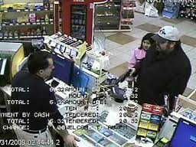
Scenario
You see a man rush into a corner store. A few minutes later he rushes out, gets in a car and the car drives away quickly.
What do you do?

Slide 12
The 4th Amendment states that citizens have…
“…the right to be secure… against unreasonable searches and seizures…”
Use of force by police is considered a seizure
Why are peace officers able to use force on ordinary citizens?

Slide 13
Graham vs Connor (1989)
Let’s review the case…
What were the facts – what happened?
What did the court decide?

Slide 14
US Supreme Court
Applied an objective standard to a force situation and further established how reasonable force must be judged objectively (Graham v Connor, 490 U.S. 386, 109 S.Ct. 1865) (1989)).

Slide 15
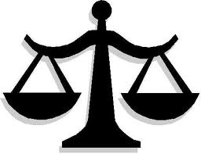
“Objective Reasonableness”
Subject’s Fourth Amendment right to remain free from any unreasonable seizure
The government’s interest in maintaining order through effective law enforcement

Slide 16
How to gauge reasonableness
The severity of the alleged crime
Whether the subject poses an immediate threat to the officer(s) or other(s)
Whether the subject is actively resisting arrest
Any attempts by the subject to evade arrest by flight

Slide 17

Break…

Slide 18
But wait, there’s more….
Chew v. Gates, 27 F.3d 1434 (9th Cir. 1994)
Chew was stopped for a traffic violation.
Chew subsequently fled on foot, and hid in a scrap yard. The police units and a helicopter were called out.
A K9 located Chew and contacted him several times. Chew sustained lacerations to his arm.
Chew stated he did not resist at any time, and he repeatedly begged the officers to restrain the dog.
The controlling officer instead ordered the attack according to Chew.

Slide 19
Chew v. Gates
On the other hand, the officer denied ordering the attack, and maintained that when he first saw Chew, he was hitting the dog with a pipe. The officer then began kicking at Chew in an attempt to disarm him. The canine officer acknowledged that he might have kicked Chew in the head, face or body. Chew brought anaction in federal court, alleging violations of his Fourth and Fourteenth Amendment rights.
The 9th Circuit ruled that a 5th factor should be considered when evaluating police use of force: the availability of other means to apprehend the suspect.

Slide 20
So how do the courts evaluate LE Use of Force?
The severity of the alleged crime
Whether the subject poses an immediate threat to the officer(s) or other(s)
Whether the subject is actively resisting arrest
Any attempts by the subject to evade arrest by flight
the availability of other means to apprehend the suspect (may be a factor considered by the courts)

Slide 21
The reasonableness of a particular use of force must be:
Judged from the perspective of a reasonable officer
Examined through the eyes of an officer on scene at the time the force was applied (not by 20/20 hindsight)
Based on the facts and circumstances confronting the officer
Based on the knowledge that the officer acted properly under the law

Slide 22
Officer’s Perspective
The “reasonableness” of a particular use of force must be judged from the perspective of a reasonable officer on the scene, rather than with the 20/20 vision of hindsight.
“the amount of force necessary for the situation is determined by the objective reasonableness as judged by a reasonable officer given the officer’s training and experience.” ~US Supreme Court

Slide 23
Reasonable Officer Defined:
An officer with similar training, experience, and background in a similar set of circumstances, who will react in a similar manner.

Slide 24
Considerations for the
Reasonable Officer Standard
Officer’s Training
Experience
Perception of the resistance at the time

Slide 25
Public Expectations
Peace officers have the skills to subdue violent and dangerous individuals
We are expected to use the amount force that is reasonable to affect the lawful purpose intended
Force should never be used as punishment
In our legal system the Courts punish, we do not

Slide 26
Officer’s Intent
The objective for the use of force is…
Control
Of an individual(s) or
A situation

Slide 27
Reasonable Officer Standard
Would another officer
with like or similar training and experience,
facing like or similar circumstances,
act in the same way or use similar judgment?

Slide 28
Use of Force Conceptual Models/Continuums
Force models or continuums provide a way for LE to think about use of force.
There are many models; circles, ladders, steps, wheels, etc.
USE OF FORCE MODELS ARE NOT THE LAW, THEY ARE USED TO HELP US CONCEPTUALIZE USE OF FORCE DECISION MAKING.

Slide 29
WSCJTC Use of Force Model
Level 1 Control: control tactics intended to control a suspect providing passive, active-static or active-egressive resistance.
Level 2 Impede: Uses body impact tools (kicks, punches, strikes) impact weapons, ECDs, OC, and similar force to overcome aggressive resistance from a suspect.
Level 3 Stop: Termination tactics designed to immediately end aggravated aggression by suspects. These tactics have the highest probability of causing death or serious physical injury.

Slide 30
WSCJTC Continuum of Resistance
Passive Resistance: suspect is a “non-helper”, dead weight, using no energy.
Active Resistance: suspect is using energy to defeat apprehension.
  Static Resistance: suspect is generating isometric muscular tension to defeat apprehension efforts.
  Egressive Resistance: suspect is attempting to escape control using reactive, non-aggressive movement.
  Aggressive Resistance: suspect is attacking and attempting to assault or injure.
  Aggravated Aggressive Resistance: suspect is attacking using weapons, multiple suspects, pre-planned ambush, etc.

Slide 31
Questions?

Slide 32
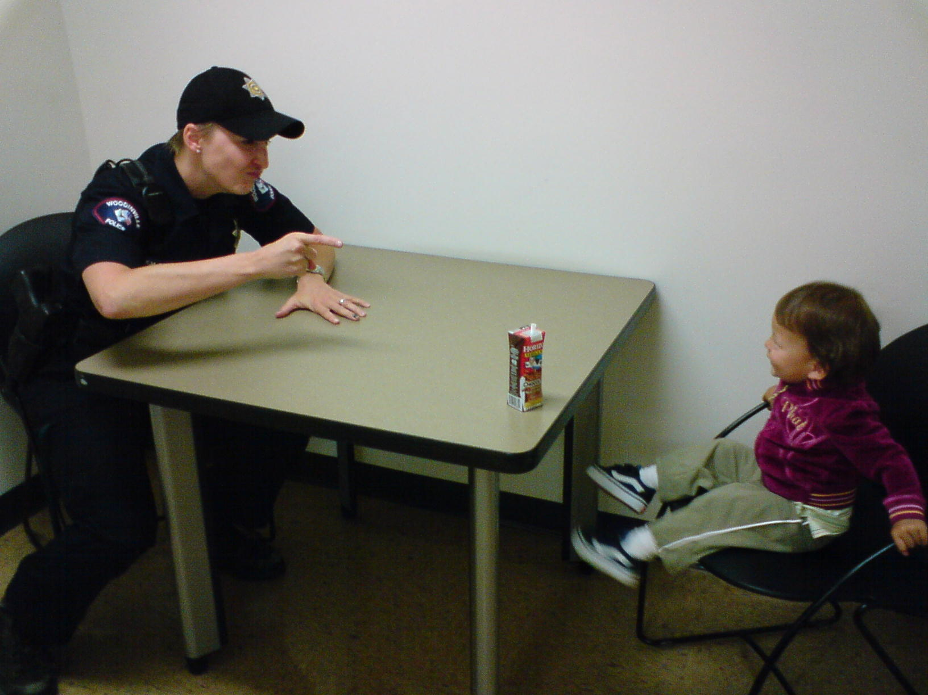
Questions?

