Slide 1
CRIMINAL INVESTIGATIONS
Purpose
This unit will provide the student with the basic knowledge to properly process a crime scene, and to arrive at a correct conclusion based upon discovered evidence.

Slide 2
LAW ENFORCEMENT OFFICER’S APPROACH
The officer’s approach to thinking is considerably different from that of the rest of society.
During any investigation, we must believe nothing we are told.
  Victims lie and distort facts.
  Fear, insurance fraud, emotions.
  Witnesses lie and distort facts
  Persons who dislike police, suspects lie to conceal truth, emotions.

Slide 3
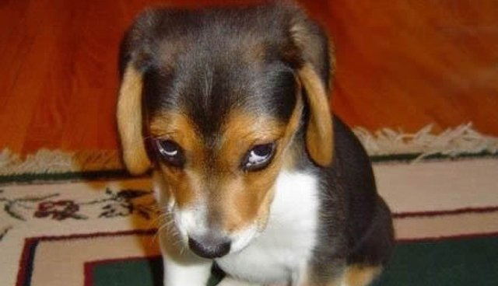
Guilty until proven innocent?
Everyone is a suspect until proven otherwise.
Obtain as much information as possible from everyone at the scene.

Slide 4
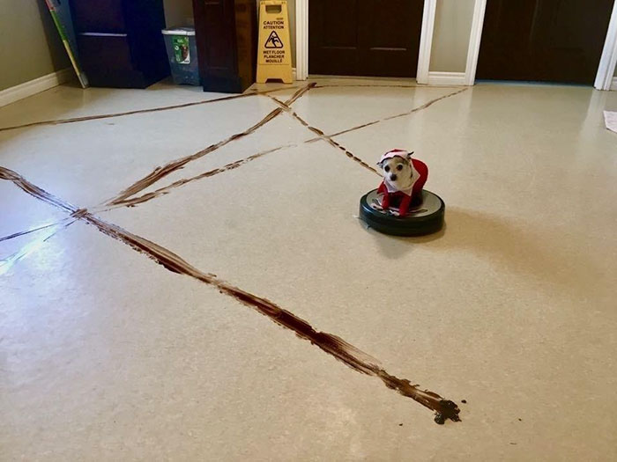
PROTECTION OF THE CRIME SCENE
Treat every scene as a worst case scenario until it can be proven otherwise.

Slide 5
PROTECTION OF THE CRIME SCENE
Paramount to any crime investigation is the protection of that crime scene to avoid destruction of evidence or alteration of the scene.

Slide 6
PROTECTION OF THE CRIME SCENE
Preservation of life.
  Preservation of Life trumps preservation of evidence.
  Unless immediate threat of death or serious injury is present, leave all objects and animals as discovered until processing the scene.
  While administering life saving measures, attempt to preserve as much of the scene as possible.
You may be the lead investigator in an animal case.
  Law enforcement is your backup, use them.

Slide 7
PROTECTION OF THE CRIME SCENE
First arriving officer’s responsibility:
Protection of the crime scene:
  Persons entering or exiting the scene must have authorization of the officer in charge of protection of the scene.
This not only includes onlookers, but also the press, family, etc. Some of the worst offenders of this are other officers who are curious (this includes brass). Without definite need to enter, they should not be allowed in. If they do enter, they take responsibility of the scene. Generally, most departments have policies governing this incident.
  Injured animal/human exception:
Health and life are always of utmost importance, even though evidence may be destroyed. The officer should instruct paramedics as to how to enter the scene (without interfering with their work). This will limit the destruction of evidence.

Slide 8
PROTECTION OF THE CRIME SCENE
  Keep the scene in the same condition as when the suspect left:
First, make an initial cursory search of the scene, being sure not to alter anything; then set up a perimeter.
  The crime scene will provide the investigator with a starting point.
  The success of an investigation and subsequent prosecution depend upon the actions of the first officer on the scene.
Begin Note Taking
This includes what you did (showing the five senses), what specialized units were called, and what they did, etc.

Slide 9
CRIME SCENE LIMITS
The size of the crime scene must be determined and limits must be set to keep out potential violators.
How large is the crime scene?
Definition: There area that includes all direct traces of the crime as determined by the type of crime committed.
  Indoors – The central scene and, where possible, the criminal’s entry and exit paths.
Outdoors – An ample area should be roped off to include the suspect’s paths to and from the central crime scene

Slide 10
CRIME SCENE LIMITS
Does the individual have a purpose at the scene?
        If not, he/she leaves.
These are gawkers, curious police, or other support personnel, who have no business there.
        If so, when finished he/she leaves.
Examples of these are medical personnel or evidence specialists, who have specific purposes (lifting of prints, photos, etc.).
        Record names and addresses for later elimination purposes.
This is done to sort fingerprints.

Slide 11
CRIME SCENE LIMITS
      *Safety Line
      *Media may enter
Officers at the scene should under no circumstances give information to reporters. There should be a designated press relations officer or supervisor for that task. (Use that for a reason.
Photography by media is permitted
Items to remember:
Do not pose.
News reporters should not be allowed to photograph the crime scene without permission from the officer in charge.
Press should not learn of specific clues or conditions at the crime scene that may be essential to the solution of the crime. In general, only the criminal profits from that. (Example: Destruction of evidence he/she has in his/her possession.)

Slide 12
CRIME SCENE LIMITS
Evidence Line
        Everything inside this line is being protected for physical evidence.
        Keeps out everyone but law enforcement personnel.
Crime scene violators
    Locard’s Law applies to these also:
        Police, Fire, gawkers, weather, animals, etc.
Locard’s Law includes anybody or anything that enters or exits the crime scene.
        Require personnel, who have a need to enter, to do so with their hands in their pockets, and instruct them where to walk.

Slide 13
MOST COMMON EVIDENCE CATEGORIES:
Testimony
  Excited utterance
    Statements made while still under stress from an event.
  Suspect, victim, or eyewitness
    Courts are beginning to question confessions made by defendants, as well as testimony of any eyewitness. Prosecutors realize that we need corroboration by the physical evidence.
Circumstantial or indirect
  When a series of facts unrelated to an argument leads to a deduction that supports that argument.
Physical
  Any type of evidence having an objective existence.

Slide 14

PHYSICAL EVIDENCE
Physical evidence cannot lie.
Essential to a successful conviction.
Physical evidence can take any form.
    Can be as large as a house;
    Can be as small as a fiber;
    Can be as fleeting as an odor.

Slide 15
PHYSICAL EVIDENCE
Can prove a crime was committed.
  Example: In the case of rape, you need to show lack of consent. Physical evidence can show this through torn clothing or injuries.
  Example: In the case of arson, there must be some type of combustible present in the area of ignition (gas, kerosene, etc.)
Can prove a suspect was at the scene. The presence of animal hair or mud from the scene on the suspect.

Slide 16
    Can establish the identity of persons associated with the crime. A specific M.O. (surgical gloves at scene, or a specific type of entry.)
    Can exonerate the innocent. Lack of drugs in the victim’s bloodstream when he claims he was drugged.
    Can corroborate the victim’s testimony. The victim’s blood, prints, etc., at the scene or on the suspect.
    A suspect confronted with the evidence may make a confession.
    Physical evidence is more reliable than testimony. Physical evidence does not change, whereas, over a period of time or through talking to people, a witness may fill in areas that were not observed.
    Has become more important due to court cases. Courts not allowing testimony due to hearsay or violation of Miranda.
    Physical evidence is expected by juries.
    Lack of physical evidence may provide useful information. Lack of point of entry at a burglary scene, or a lack of footprints in fresh snow at the scene.

Slide 17
INFORMATION AND PHYSICAL EVIDENCE
Considering the impossibility that everyone is a suspect, we must utilize information and physical evidence to reduce the number of suspects.
Information
Primary to locating a suspect:
Upon arriving at a crime scene, contact possible witnesses or victims; obtain suspect information (description, direction of travel, vehicle or on foot, etc.) and broadcast it
Secondary to convicting a suspect:
  Testimonial evidence;
  Identification of possible suspect through photo line-up, or positive identification if a suspect is detained.

Slide 18
PHYSICAL EVIDENCE
Primary to convicting a suspect:
Fingerprints or blood at the scene will not immediately locate a subject, but it will assist in the conviction.
Secondary to locating a suspect:
The same fingerprints taken at the scene may be matched and will assist in identifying a suspect and possibly obtaining a warrant.

Slide 19
LOCARD’S LAW
It is not possible to come into contact with an environment without changing it in some way, whether by adding to (prints, blood, etc.) or subtracting from (stereo, serial numbers, mud, etc.).

Slide 20
LOCARD’S LAW
An understanding of Locard’s Law makes it clear that we will always have physical evidence at a crime scene.
When a suspect enters a crime scene, the suspect will leave something of himself/herself and take something from the scene when exiting.
Theory of Transfer is the leaving of something or taking away of something at the scene.
Theory of Mutual Exchange applies to the greatest extent in the crime of rape (exchange of semen). There is also a possibility of exchange in situations of assault and a mutual exchange of blood or other body fluids.

Slide 21
LOCARD’S LAW
There will always be a transfer.
Does crime scene warrant complete search?
  A more serious crime requires a more thorough search.
  This is where you, as an initial officer on the scene, have to make a determination as to how many man-hours should be spent investigating this incident. It can be as little as taking a few statements and writing a report, as much as having an evidence technician obtain prints and pictures, or as great as having detectives and Identification Section respond.

Slide 22
CLASS AND INDIVIDUAL CHARACTERISTICS
Our process of elimination continues with the use of class and individual characteristics as tools.
    Tools Used For Elimination

Slide 23
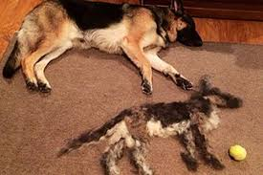
CLASS CHARACTERISTICS
True of more than one
  Fibers
  Paint
  Hair
  Blood types: Typing as is A-B-O or animal or human, but it cannot determine an individual. The exception to this rule is the DNA processing where blood can now be identified to a single person.

Slide 24
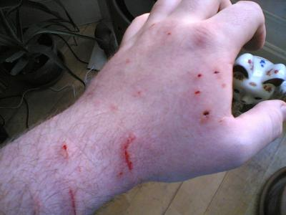
INDIVIDUAL CHARACTERISTICS
  True for only one, unique
    Finger, palm, and foot prints
    Bite marks
    Tool marks
    Blood with DNA processing

Slide 25
INVESTIGATIVE HYPOTHESIS
To make the best use of obtained facts during an investigation, it is best to have a plan. A plan that may be used in any form of investigation is the development of an investigative hypothesis.
Have a reasonable set of assumptions.
As an experienced investigator, you will begin making assumptions even when dispatched to a call, due to prior experiences.
Who, What, Where, When, Why, How:
You should attempt to answer all of these questions on the initial contact.

Slide 26
INVESTIGATIVE HYPOTHESIS
Base assumptions upon actual observations.
After making initial contact, you develop a theory as to what occurred and how to continue.
The hypothesis must be reassessed.
By doing further investigation (obtaining physical evidence) and follow-up, you reassess your theory.
Does the theory still stand based upon these new facts?
Corroborating evidence, testimony from witnesses, etc.
We don’t change facts to match theory: Change theory to match facts.
The theory may change based upon new facts.
The theory must match new facts.

Slide 27
PRINCIPLES OF CRIME SCENE SEARCH
To properly search a crime scene without the loss of evidence during the process, we must consider the following principles of crime scene investigation.
Be thorough:
    If it is avoidable, do not examine an outdoor crime scene until good daylight prevails. Certain evidence that cannot be discernible in artificial light shows up quite clearly in daylight.
    Evidence and information of a fragile nature should be collected before material that is less likely to be destroyed.

Slide 28
PRINCIPLES OF CRIME SCENE SEARCH
Find everything that’s there.
  Minute trace evidence (examples: hairs, fibers, glass fragments, etc.)
Ways of collection include:
  Specially equipped vacuums;
  Shaking items onto a clean sheet of paper;
  Cellophane tape.
  Take a 4” piece, press it on the suspected area and then press onto a slide. Never use transparent tape for paint chips or hair. Tape will possibly destroy the surface of the paint, and it appears metallic under the microscope.
  We cannot afford to lose any evidence.
Remember Locard’s Law. Also, never touch, change, or alter anything until identified, photographed, measured, and recorded.

Slide 29
PRINCIPLES OF CRIME SCENE SEARCH
Be organized
  We save time and limit contamination
  When searching the scene of a crime, a method should be your guide. Proceed in a systematic manner.
  Searches of a crime scene, particularly when the area is extensive, presents varied problems. It is essential that proper consideration be given to all aspects of the search problems before proceeding, in order that the search can be as complete and thorough as possible (as in large areas).
    Assemble all personnel outside the area to be searched.
    Establish a team, designating specific individuals with specific responsibilities (recorder, photographer, sketcher, evidence gatherer – which would include taking measurements, latents, etc.). Normally, this will be done by two people.

Slide 30
PRINCIPLES OF CRIME SCENE SEARCH
  Explain in detail the type of evidence being searched for.
  Inform search parties of all information you have on the crime and the importance of recovery.
  Impress the teams with the urgency or lack of it (evidence).
  Divide the personnel into groups.
  Assign a person to be in charge of each group and assign a recorder.
  Determine the method of the search. Start at the perimeter and work toward the center in a pre-described pattern.

Slide 31
PRINCIPLES OF CRIME SCENE SEARCH
Choose a search method
Several classifications of methods:
Concentric or spiral search (circular)
Point to point (line):
  Similar to circular method, sometimes better suited for special problems.
  Gives closer coverage over a larger percentage of the area.
Area or sector search (grid)
Quadrant search: divide large areas into four small areas.

Slide 32
PRINCIPLES OF CRIME SCENE SEARCH
The number of searchers and spacing depends upon the extent of the area to be searched:
Spacing – short grass – no brush – heavy brush – further apart.
Type of evidence sought will also be a factor:
Entire group moves together clockwise;
The group will move no faster than its slowest member.

Slide 33
PRINCIPLES OF CRIME SCENE SEARCH
Work from the perimeter:
  Each group must be informed if the following experts are available:
Photographer;
Fingerprint person;
Laboratory technicians.
Means of communication must be provided for groups:
Radio;
Megaphone;
Foot-runner;
Other.

Slide 34

PRINCIPLES OF CRIME SCENE SEARCH
Vehicle search
Search the exterior of vehicle first.
Interior search:
Divide interior into sections;
Vacuum sweepings for trace evidence;
Finger print last.
Record all data and information in a report, including all evidence and facts obtained during the search and investigations. Include your logical conclusion concerning the incident, if you have one.

Slide 35
PRINCIPLES OF CRIME SCENE SEARCH
Do not destroy while marking evidence.
It is extremely necessary that every piece of evidence found during any type of search be marked for identification by the person who found it. The characteristics of the mark and where marked should be recorded.
  When to mark: Evidence should be marked at the time it is removed from its original position.
Note: NO piece of evidence should be removed from where it was found until AFTER it has been photographed, measured, recorded, and entered on the sketch of the scene.
Remember the “Golden Rule of Homicide Investigation” – Never touch, change, or alter anything until identified, measured, and photographed.

Slide 36
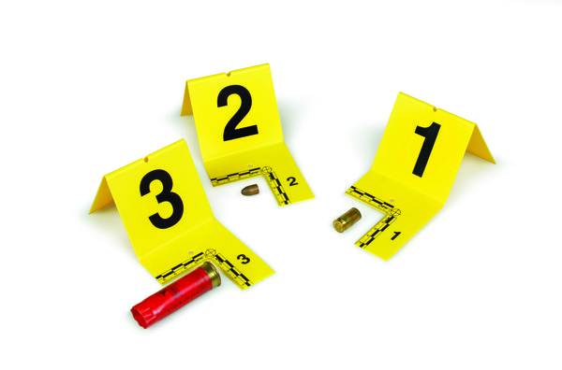
PRINCIPLES OF CRIME SCENE SEARCH
Once located, record potential evidence.
1. All items that may have evidential value should be collected and recorded (notebook – to report – to property sheet and book)
2. You search, you find, you record, you mark, you submit. You are maintaining the “chain of evidence.”

Slide 37
RECORDING A CRIME SCENE
Photograph
Mark
Photograph
Measure and Sketch
Collect
  Photograph while collecting
Use notes to document actions taken while on scene.

Slide 38
RECORDING A CRIME SCENE
To be considered now are the means of recording a crime scene used by police, and the associated rules that make these legal in court.
    Crime scene notes
    To be presented legally in court:
Must be made at the scene;
Must be made while looking at the object;
Must be verified at the scene;
Must not be altered later.

Slide 39
RECORDING A CRIME SCENE
    Necessary items:
      Date and time first reported;
      Type of crime;
      Location of the crime scene and a brief description of the area;
      Brief description of the crime or event that led to the investigation (M.O.);
      Name of the complainant;
      Names of all officers, witnesses, investigators, and special personnel at the scene;
      Names of persons conducting the search and persons who took photos, prints, sketches, etc.;
      Weather and lighting conditions;

Slide 40
RECORDING A CRIME SCENE
      Description of the scene and surrounding areas;
      Description of the interior and exterior of the crime scene (type of residence, number of rooms, windows, terrain type, etc.);
      Description of the primary crime scene;
      Location of possible evidence and names of persons who collected it;
      Date and time of conclusion;
      Must be in chronological order, accurate, and complete.

Slide 41
RECORDING A CRIME SCENE
Sketching
    Photos alone are not sufficient for recording a crime scene.
    Sketches should be made and used to complement the photos.
      A sketch will clarify the appearance of a crime scene and help make the scene easier to comprehend.
      The advantage is that sketches can be selective.
      It is essential that photographs be supplemented by a chart, sketch or diagram of the scene, showing the exact position of the various bits of evidence and their relation to other evidence.
Illustrations of a scene or event are admissible as an aid to the court or jury.
    Sketches in an officer’s notebook are never considered works of art, for seldom do you find an officer who has the ability to draw recognizable objects. However, admissibility is conditioned upon primarily showing that they are reasonably accurate and complete.
The officer drawing the sketch should also read the measurements in order to testify to those measurements at a later time in court.

Slide 42
RECORDING A CRIME SCENE
    General rules:
    Show all objects bearing on the crime:
Location of entrances to buildings;
Location of entrances to the room where the victim was found;
Type of door at each entrance (regular, screen, glass);
Side of door hinges are on and the direction of the swing;
Location of the victim in relation to stationary objects;
Location of weapon and evidence relative to victim and stationary objects;
Need two measurements to relocate objects.

Slide 43
RECORDING A CRIME SCENE
Include objects to illustrate the condition of the scene and the location of evidence.
Draw the direction of the compass (NE, SW, etc.).
  North should be at the top of the sketch when possible.
Include the name of the person who did the sketch.
Include the date;
Indicate whether the sketch is to scale; if a scale is used, note which scale.

Slide 44
RECORDING A CRIME SCENE
Methods of measurement
  Baseline – Objects are measured from a predetermined baseline.
    Generally used indoors.
  Triangulation – Where two points are known, a third may be determined.
    Generally used outdoors.
    Use permanent reference points.

Slide 45
RECORDING A CRIME SCENE
    Common errors.
        Measuring a distance by pacing and expressing the results in feet and inches;
        Relying on memory;
        Drawing the outlines of a room from accurate measurements and then putting furniture into the sketch by mere visual estimates.
    Decide what is to be sketched beforehand. Sketching cannot begin until one is sufficiently familiar with the scene.
Do NOT draw things (objects) which are clearly irrelevant to the case. The advantage of sketching over photography is that the sketch contains only the essentials, whereas the photograph often is overcrowded.

Slide 46
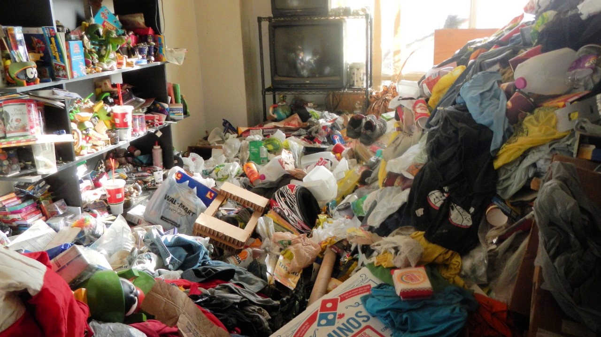
RECORDING A CRIME SCENE

Slide 47
RECORDING A CRIME SCENE
Photography
        Photographs provide a good method of reproducing the crime scene and perspective. However, the scene should first be preserved in its original, undisturbed state.
              To record the scene in its original state at the time of discovery, photographs should be taken. Keep all persons out of the picture.
              Photographs should be supplemented by detailed notes.
DO NOT DELETE ANY PHOTOGRAPHS TAKEN.
As a general rule, everything that is to be seized from the scene should be included in the photo before it is removed.

Slide 48
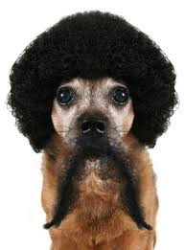
RECORDING A CRIME SCENE
Originals must not be edited!

Slide 49
RECORDING A CRIME SCENE
      Structures
The exterior of any structure should be photographed, with particular attention paid to all entrances and any signs of forced entry.
A close examination should be made of all windows and doors to determine if they were open or closed, locked or unlocked.

Slide 50
RECORDING A CRIME SCENE
Photos should be taken as follows:
            Exterior:
        A distance shot of the genera area (markers, buildings, etc.);
        A shot of the point of entry into the crime scene (looking towards the scene);
        A shot of the immediate scene (preferably from the point of entry);
        Pictures of all bits of evidence (and their positions in relation to other evidence);
        A shot from the immediate scene towards the point of exit;
        A shot of the point of exit, if known.

Slide 51
RECORDING A CRIME SCENE
            Interior:
A distance shot to show the location of the building in relation to the closest intersection;
A close-up of buildings showing the address;
A shot of the entrance;
Complete photos of those areas where activities leading to the commission of the crime took place;
Shots of movement through the building. (Example: In a burglary, it may be necessary to show the condition of nearly every room in the home, if they have been searched during the crime.)

Slide 52
RECORDING A CRIME SCENE
When photographs are taken, they should not be:
    Immaterial or irrelevant;
    Unduly incite prejudice or sympathy.
        Photographs are not admissible merely because they bring vividly to the jurors the details of a shocking crime or tend to arouse passion or prejudice.
        It is only when photographs do not illustrate or make clear some issues of the case and is of such a character as to unduly prejudice the jury.
    Distorted (they should be a true representation of the scene).
Photograph from eye level.

Slide 53

RECORDING A CRIME SCENE
You can never take too many photographs.
  It is much better to have 12 photographs of an injury later determined to be irrelevant than to not have any of an injury later determined to be relevant.

Slide 54
RECORDING A CRIME SCENE
      Marking devices in the field of view.
        Rulers are a good method to represent the relationship of objects;
        Identifying letters;
        Similar marking devices as aids: chalk marks, string, etc.;
        Occasionally, the admissibility of a photography showing markings is contested on the grounds that it does not truly represent the original scene.
Take two photographs of each piece of evidence: One with a marking device and the other without.

Slide 55
RECORDING A CRIME SCENE
      Victims
        Photographs should be taken from all possible angles.
        It is impossible to over-photograph a controlled and protected crime scene.
        Obtain a photograph of that portion of the body that was not visible when it was discovered (i.e., the back of the body if the body was found on its back).
      Witnesses
        Try to get photographs from the approximate location from which they saw the crime.
        At the first opportunity, statements should be taken from the witnesses.
        A review of the photo often will keep a witness from becoming confused during intensive cross-examination at trial time.

Slide 56
RECORDING A CRIME SCENE
      Clothing
        A description of the victim’s clothing should be recorded before moving the body.
        If all or a portion of the victim’s clothing has been removed, it should be photographed where found prior to being retrieved and accurate measurements of its location should be noted.
Weapons
All obvious weapons, as well as potential weapons, should be photographed where found before being removed.
Sometimes the exact location of a weapon is such that it cannot be photographed. In that case, a photograph of the general area should be taken and notes should be made that will permit accurate testimony later.

Slide 57
RECORDING A CRIME SCENE
Scrape/Drag Marks
It is important to obtain photographs of all scrape marks, drag marks, and what appear to be scuffle marks.
            For example, dragging a body through weeds and grass will be shown by bent and broken twigs and grass, while the heels of someone being dragged through sand will leave two rather distinctive furrows.
            Scrape, drag, or scuffle marks often play important roles in determining what actually happened before, during, and after the homicide.

Slide 58
RECORDING A CRIME SCENE
Impressions
If there is a dirt surface, tire, shoe, or boot impressions may be available.
There is the possibility of fabric impressions being a viable since homicide victims are sometimes disposed of in out-of-the-way locations that may be very dusty and dirty.
Any such impressions must be photographed, and a ruler should be included in the photograph.
Oblique lighting is used to cast a shadow across impressions to highlight details.

Slide 59
TRACE EVIDENCE
Always keep Locard’s Law in mind when dealing with trace evidence. Every crime scene has some form of evidence. Large evidence items are usually obvious, but this is not always true with trace evidence. Trace evidence is generally defined as that which by its size is very easily overlooked and, therefore, must be treated more carefully.

Slide 60
TRACE EVIDENCE
Small material
Microscopic or macroscopic
Easily overlooked
Due to the size of trace evidence, it is easily overlooked.
Easily transferred

Slide 61
TRACE EVIDENCE
Fibers and textiles
Fragments of cloth could give class as well as individual characteristics. Larger pieces of fabric are generally needed for conclusive characteristics. Items looked for are colors, type of cloth, direction of fiber twist, and thread count.
Types of textile fibers:
Wool;
Vegetable fiber (cotton);
Synthetics (polyester);
Mineral (glass wool);
Blends.
Dust
Ash
Soil
Wood, etc.
Hair

Slide 62
TRACE EVIDENCE
HAIR:
Generally associated in crimes involving physical contact.
Hair has three parts:
Root
Gives little help as to origin.
Usually will be missing.
Tip
Shaft

Slide 63
TRACE EVIDENCE
Considerations regarding trace evidence
      Collection:
        Legal aspects;
        Scientific aspects;
        If the item may be lost or dislodged, control or known samples should also be obtained.
      Packaging
      Value

Slide 64
IMPRESSION EVIDENCE
Impression evidence may be found.
      There are several types of impression evidence found at or near a crime scene:
        Footprint;
        Tire;
        Tool impressions.
Generally preserved only if they contain details of value for identification

Slide 65
IMPRESSION EVIDENCE
      Lifting and casting of impression evidence.
        Begin by protecting the impression from alteration or destruction.
        Photograph and sketch prior to casting.
        Plaster of Paris is used for casting of shoe and tire impressions.
Impressions in loose dirt, sand, and dry snow should be sprayed with shellac prior to casting.
Casting of tool impressions should be the last resort.
  Attempt to remove impression to the lab.
If a casting is done, silicone rubber should be used.

Slide 66
PACKAGING EVIDENCE
Once located, there are also rules and methods of packaging evidence which must be followed to maintain control of that evidence.
    Evidence is packaged to prevent:
      Damage;
      Contamination;
      Undetected tampering.

Slide 67
PACKAGING EVIDENCE
    Packaging materials:
      Packaging materials is relatively unimportant.
        No plastic bags, excluding check carrier;
        Brown paper bags, envelopes, pill boxes, Styrofoam cups, cardboard boxes, etc.
        For deceased animals, wrap head and paws individually in paper.
        Some evidence may need special processing prior to packaging.
Be aware of contamination possibility.
    Sealing the package:
      Transparent tape over seams;
      Avoid masking tape;
      Initial over tape and seams.

Slide 68
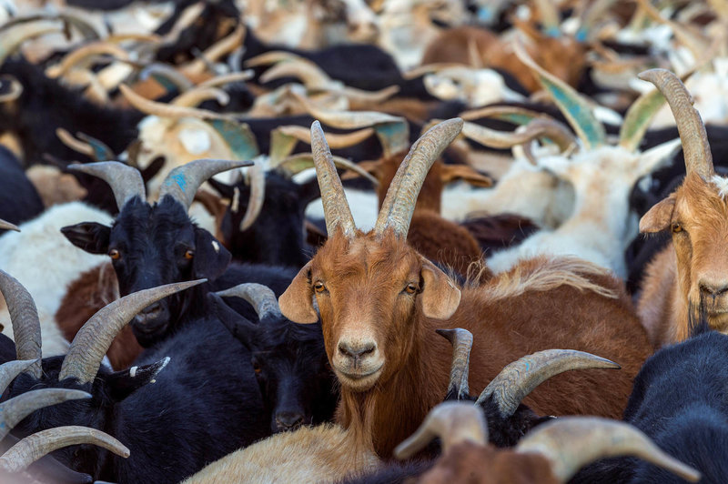
GROUP EXERCISE

Slide 69
CONCLUSION
Treat every scene as a worst case scenario until proven otherwise.
Treat all subjects as suspects until proven otherwise.
Establish crime scene based on evidentiary needs.
Protect the crime scene until thoroughly processed.
A subject will always leave something behind and take something with them.
Photograph, mark, photograph, sketch, collect (while photographing).
Proper scene processing and evidence collection is essential to successful conviction.
Follow your chain of command when additional resources are needed.

Slide 70
The End
Questions?

